Slide 1
Pokémon Battle Outcome Classifier
Jacky

Slide 2
Problems
Can I guess/predict the outcome of a Pokémon battle?
But rather than problems, there are more opportunities:
Looking for patterns in Pokémons (eg creating new Pokémons)
AI plays Pokémon battles
AI builds teams of Pokémon

Slide 3
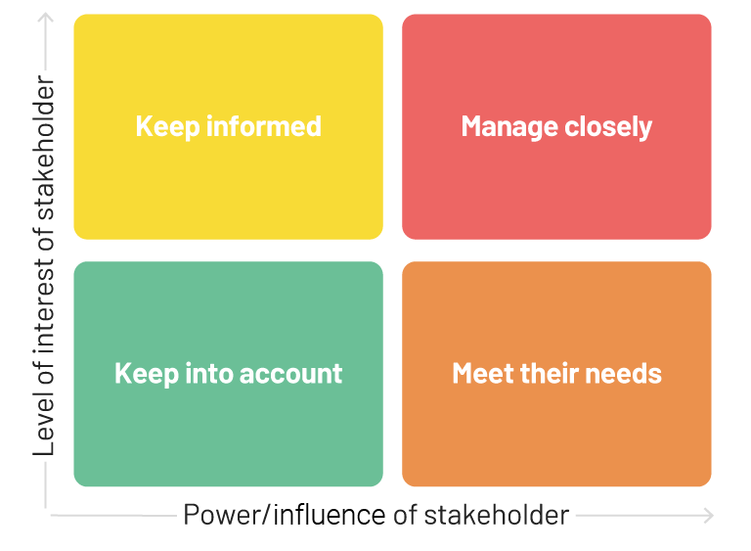
Stakeholders (real life)
Pokémon streamers (e.g. The Official Pokémon YouTube channel)
May use the model as a tool, to create more content to talk about
Pokémon gamers/Pokémon Video Game Championships (VGC) participants
Focus on team building and strategy
They create data
Website: https://pokemonshowdown.com/
Organiser of a Pokémon battle platform
They are the rules
Pokémon game developers
create the game and Pokémons
They are the creators
organisers
gamers
streamers
game developers

Slide 4
Stakeholders (world of Pokémon)
Basically all Pokémon trainers
just like VGC participants in real life
Gyms, Pokémon League, Elite Four, Champion
Organiser of Pokémon battles
With the characteristics of Pokémon trainers
Pokémon Researchers
Not sure
Pokémon villain teams (bad guys)
Not sure how they affect or could be affected
But any technology offered to them is bad
Gyms, Pokémon League, Elite Four, Champion
pokémon trainers
villain teams
researchers

Slide 5
Measure the performance
For gamers and VGC participants (trainers and villains):
They care if this will bring them victory (how much they can win rather than lose)
Most likely Accuracy and Precision (PPV), as there is no punishment on losing a battle, but depending on their battling style
For organisers:
Everything, as they make the rules
For game developers:
Similar to organisers
But may want to know which Pokémons are popular/strong/weak
So that they can boost/buff/nerf them, balance the game
For Pokémon researchers:
Tell them Everything

Slide 6
Costs of mis-identifying
Positive = win
Negative = Lose
In my opinion:
Cost of False Negative > Cost of False positive
no penalty on losing a battle, but emotional or psychological
The cost of negative is decided to be twice as much as cost of positive, due to Loss aversion by Amos Tversky and Daniel Kahneman.

Slide 7
Can machine learning model help?
Not sure
But we can always try
Aim to classify each battle by just looking at pokemons’ base stats
Since classification problems, ROC, AUC and confusion matrix is going to be the measurement of success and indicator of model training and selection

Slide 8
machine learning model process
Gather data
Clean them
Train-test-split
Exploratory Data Analysis
Model training
Hyperparameter optimisation
Check performance

Slide 9
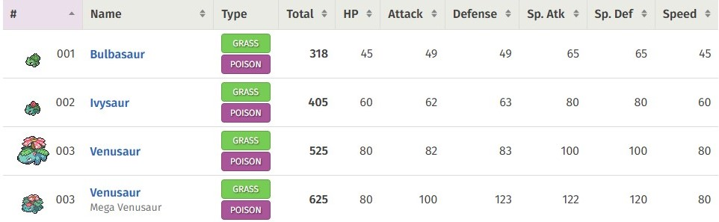
Data collection
Pokémon stats data, from https://pokemondb.net/

Slide 10
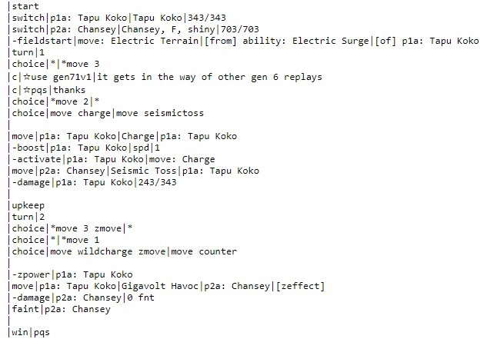
Data collection
Pokémon 1v1 battle data, from https://pokemonshowdown.com/

Slide 11
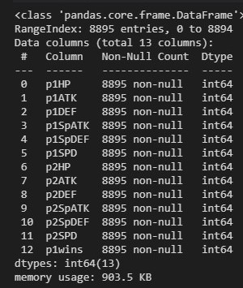
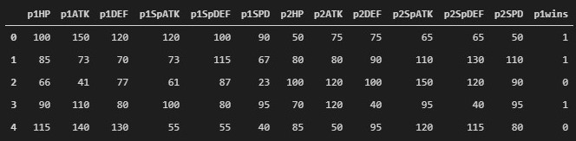
Data format
Each battle is a row of data
Contains base stats of pokemon1, pokemon2 (predictors)
Labels (target) is whether pokemon1 won that battle (1: won, 0: lost)

Slide 12
Data cleaning
Since the raw data was collected from previous projects, Null data is confirmed to be excluded
Only need to get rid of the duplicated rows

Slide 13
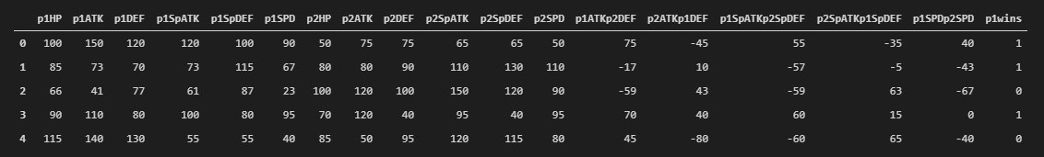
Feature engineering
From a very naïve point of view:
The difference between pokemon1’s attack attributes and pokemon2’s defense attributes
The difference of speed

Slide 14
Exploratory Data Analysis
Train-test-split was done before, randomly
Only about the train data
Correlation matrix
Logistic regression coefficients analysis
Histograms

Slide 15
Exploratory Data Analysis
From the correlation matrix, those numbers (coefficient of correlation) are so small, but:
1. feature 0 (p1HP)
2. feature 5 (p1SPD)
3. features 6 to 11 (all p2 stats)
4. feature 13 (p2ATKp1DEF), feature 15 (p2SpATKp1SpDEF) and feature 16 (p1SPDp2SPD)
Features 6-11, 13 and 15 show negative correlations, which are expected will enhance the probability of pokemon 1 winning.
However, features 0, 5 and 16 are not expected to be having negative correlations, could suggest that HP and Speed are not affecting the probability of pokemon 1 winning.

Slide 16
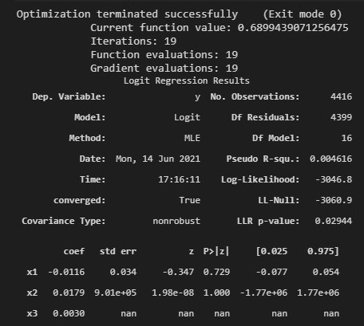
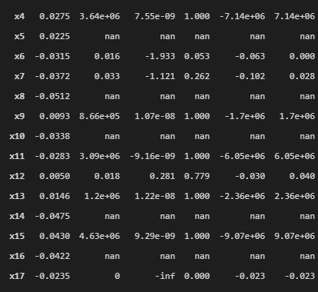
Exploratory Data Analysis
Some of the p-values are nan, not sure why (immediate reason is due to invertible matrix, or the hessian matrix is not invertible
Only features x6 and x17 are acceptable, which are p1SPD and p2SpATKp1SpDEF, in terms of p-values.

Slide 17
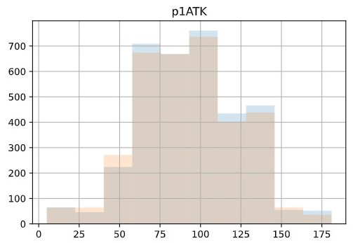
Exploratory Data Analysis
The histograms show the distributions of labelled data for each feature.
Most of the case are overlapping so that it is hard to classify them by looking at each feature, suggesting there is no significant pattern for the model to identify and distinguish whether winning or losing.

Slide 18
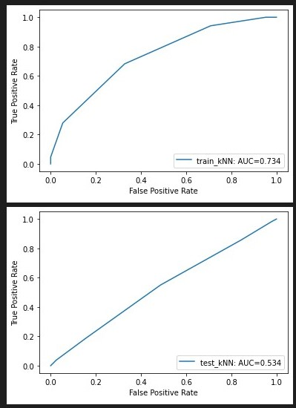
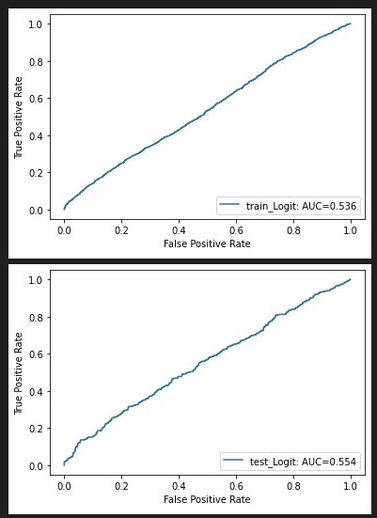
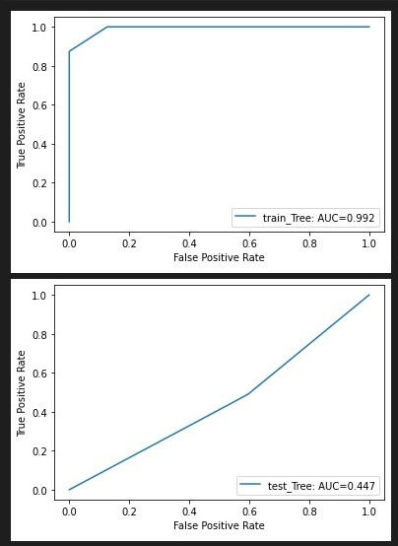
Should we still apply modelling?
If commercial, no
If for fun, yes
kNN, logistic regression and decision tree
However, during training, overfitting and memorisation were an issue
kNN
logistic regression
decision tree

Slide 19
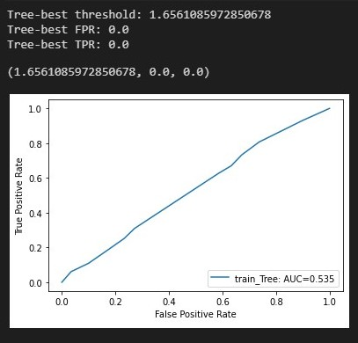
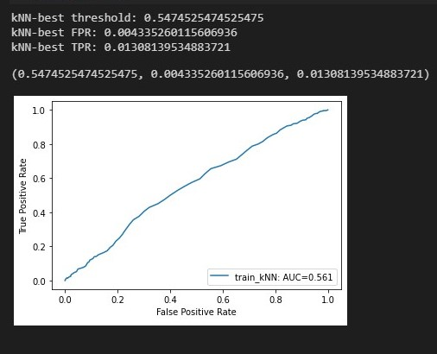
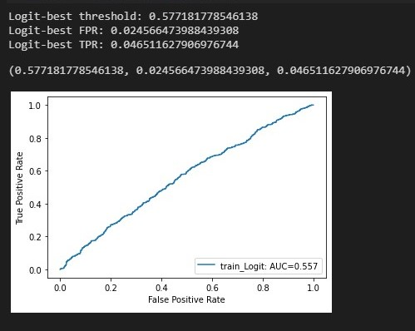
Validation results and fm optimisation

Slide 20
FPR and TPR changes rapidly and dramatically with some crictical values, especially for Decision tree.
Getting an Optimised threshold values is not helpful in these models, since the predictions are too sensitive and extreme to different thresholds. Just a slight change on the costs can results in completely opposite predictions.
This may suggest fm Optimisation in an unsignificant model is hard, all depends on which error, FP or FN, is more except able or favorable.
Even within the validation dataset, the fm Optimisation with cost_negative=2 caused the model to predict mostly False and all False in Decision tree model (due to the threshold > 1).
If we aim to getting better looking results on TPR and FPR, we have to tune the costs
but then this action violates the main idea of fm Optimisation.
Therefore, I would say fm Optimisation is not applicable in these models.

Slide 21
Conclusion
each model gives an AUC of around 0.5, making them perform roughly the same as random guessing.
The reason could be due to:
lack of data,
data memorisation,
or just simply Pokémon is too good on having a balanced game such that the outcome of a Pokémon battle doesn't relate too much with Pokémons' base stats.

Slide 22
Future works
Pokémon battle outcome is not solely related to Pokémons' base stats, but also many other factors.
analyse even more attributes of each Pokémon, such as types, weaknesses, abilities or natures
investigate what other factors hidden in each battle, such as number of turns, items carried, or what moves are

